Slide 1










Introduction to
Algorithm Design and Analysis
[5] HeapSort
Yu Huang
http://cs.nju.edu.cn/yuhuang Institute of Computer Software Nanjing University

Slide 2

In the last class …
The sorting problem
Assumptions
InsertionSort
Design
Analysis: inverse
QuickSort
Design
Analysis

Slide 3

Heapsort
Heap
HeapSort
FixHeap
ConstructHeap
Complexity of Heapsort
Accelerated Heapsort

Slide 4






How HeapSort Works
Elements to be sorted
Elements sorted
Priority Queue
Implement
Heap
Fibonacci Heap
Binomial Heap

Slide 5


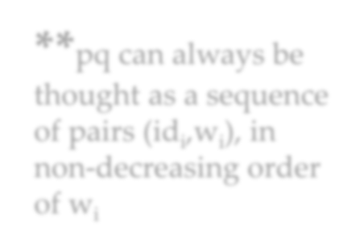


Elementary Priority Queue ADT
“FIFO” in some special sense. The “first” means some kind of “priority”, such as value(largest or smallest)
PriorityQ create()
Precondition: none
Postconditions: If pq=create(), then, pq refers to a newly created object and isEmpty(pq)=true
boolean isempty(PriorityQ pq)
precondition: none
o int getMax(PriorityQ pq)
**pq can always be thought as a sequence of pairs (id_{i},w_{i}), in non-decreasing order of w_{i}
precondition: isEmpty(pq)=false
postconditions: **
o void insert(PriorityQ pq, int id, float w)
precondition: none
postconditions: isEmpty(pq)=false; **
o void delete(PriorityQ pq)
precondition: isEmpty(pq)=false
postconditions: value of isEmpty(pq ) updated; **
o void increaseKey(PriorityQ pq, int id, float newKey)

Slide 6


Heap: an Implementation of Priority Queue
A binary tree T is a heap structure if:
T is complete at least through depth h-1
All leaves are at depth h or h-1
All path to a leaf of depth h are to the left of all path to a leaf of depth h-1
Partial order tree property
A tree T is a (maximizing) partial order tree if and only if the key at any node is greater than or equal to the keys at each of its children (if it has any).

Slide 7

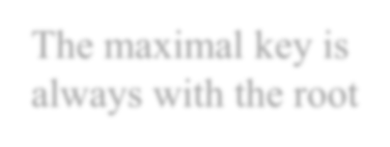


Heap: Examples
The maximal key is always with the root
50
9
24
30
5
7
20
21
18
3
1
4
3
6
12
5
6

Slide 8
Heap: an Implementation of Priority Queue
Heap structure
Heap
Partial order property

Slide 9


HeapSort: the Strategy
heapSort(E,n)
Construct H from E, the set of n elements to be sorted; for (i=n;i≥1;i--)
curMax = getMax(H); deleteMax(H);
E[i] = curMax
deleteMax(H)
Copy the rightmost element on the lowest level of H into K; Delete the rightmost element on the lowest level of H; fixHeap(H,K)

Slide 10










FixHeap
Input: A nonempty binary tree H with a “vacant” root and its two subtrees in partial order. An element K to be inserted.
Output: H with K inserted and satisfying the partial order tree
property.
Procedure:
fixHeap(H,K)
if (H is a leaf) insert K in root(H);
else
Set largerSubHeap;
One comparison: largerSubHeap is left- or right-
Subtree(H), the one with larger key at its root.
Special case: rightSubtree is empty
if (K.key≥root(largerSubHeap).key) insert K in root(H)
else
insert root(largerSubHeap) in root(H);
Recursion
fixHeap(largerSubHeap, K);
return
“Vacant” moving down

Slide 11

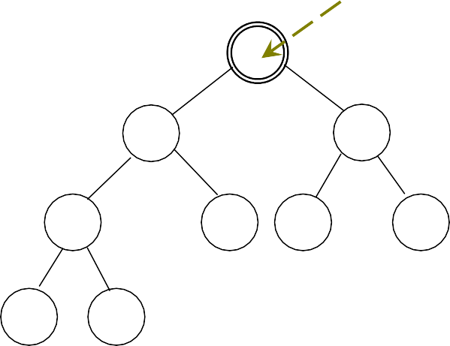




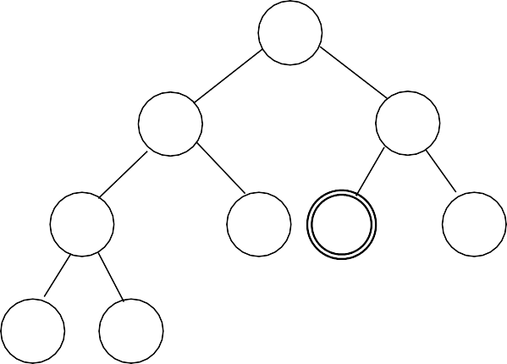
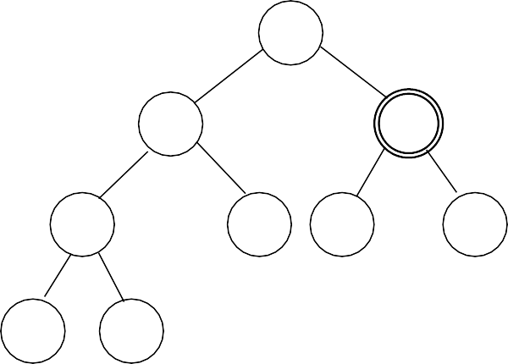

FixHeap: an Example
vacant
50
24
30
24
30
20
21
18
3
20
21
18
3
12 5
6
12 5
K=6
30
30
24
18
24
20
21
3
20
21
18
3
12 5
K=6
12 5

Slide 12


Worst Case Analysis for fixHeap
2 comparisons at most in one activation of the procedure
The tree height decreases by one in the recursive call
So, 2h comparisons are needed in the worst case, where h is the height of the tree
Procesure:
fixHeap(H,K)
One comparison: largerSubHeap is left- or right-
Subtree(H), the one with larger key at its root.
Special case: rightSubtree is empty
if (H is a leaf) insert K in root(H)
;
else
Set largerSubHeap;
if (K.key≥root(largerSubHeap).key) insert K in root(H)
else
insert root(largerSubHeap) in root(H);
Recursion
fixHeap(largerSubHeap, K);
return
“Vacant” moving down
12

Slide 13

Heap Construction
Note: if left subtree and right subtree both satisfy the partial order tree property, then fixHeap(H,root(H)) gets the thing done.
We begin from a Heap Structure H:
void constructHeap(H)
if (H is not a leaf) constructHeap(left subtree of H); constructHeap(right subtree of H); Element K=root(H);
fixHeap(H,K)
return
root
Post-order Traversal
left
right

Slide 14


Correctness of
constructHeap
Specification
Input: A heap structure H, not necessarily having the partial order tree property.
Output: H with the same nodes rearranged to satisfy the partial order tree property.
void constructHeap(H)
H is a leaf: base case, satisfied trivially.
if (H is not a leaf) constructHeap(left subtree of H); constructHeap(right subtree of H);
Element K=root(H);
fixHeap(H,K)
Preconditions hold respectively?
return
Postcondition of constructHeap satisfied?

Slide 15



Linear Time Heap Construction!
The recursion equation:
Number of nodes in right subheap
W(n)=W(n-r-1)+W(r)+2log(n)
A special case: H is a complete binary tree:
The size N=2^{d}-1,
(then, for arbitrary n, N/2<n≤N≤2n, so W(n)≤W(N)≤W(2n) )
o Note: W(N)=2W((N-1)/2)+2log(N)
The Master Theorem applies, with b=c=2, and the critical exponent E=1, f(N)=2log(N)
Cost of fixHeap
o Note:
2log(N ) 2 log N 2N ^{ε}
lim
N →∞
= lim = lim
1-ε
N →∞ N
1-ε
N log 2 N →∞ ((1- ε) log 2)N
When 0<ε<1, this limit is equal to zero
So, 2log(N)∈Ο(N ^{E-ε}), case 1 satisfied, we have
W(n)∈Θ(n)

Slide 16


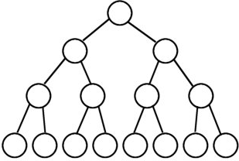
Direct Analysis of Heap construction
Heap construction
From recursion to iteration
Sum of rowsums
𝑙𝑙𝑙𝑙𝑙𝑙𝑙𝑙
𝑂𝑂(ℎ)
Cost =
� 𝑛𝑛 _{2ℎ+1} = 𝑂𝑂(𝑛𝑛)
ℎ=0
c = logn fix; h = logn; # = 1
c = 2 fix; h = 2; # = n/8 c = 1 fix; h = 1; # = n/4
c = 0 fix; h = 0; # = n/2
1 fix = 2 comparisons

Slide 17


Implementing Heap Using Array
50
9
24
30
5
7
20
21
18
3
1
4
3
6
9 | 5 | 7 | 1 | 4 | 3 | 6
12
5
6
50 | 24 | 30 | 20 | 21 | 18 | 3 | 12 | 5 | 6

Slide 18





Looking for the Children Quickly
Starting from 1, not zero, then the j th level has 2^{j-1} elements. and there are
2^{j-1}-1 elements in the proceeding
j-1 levels altogether.
50
24
30
20
21
18
3
So, If E[i] is the k^{th} element at level j, then i=(2^{j-1}-1)+k,
and the index of its left child (if existing) is
i+(2^{j-1}-k)+2(k-1)+1=2i
12
5
6
50 | 24 | 30 | 20 | 21 | 18 | 3 | 12 | 5 | 6
<5>
<10>
For E[i]:
Left subheap: E[2i] right subheap: E[2i+1]
The number of children of the nodes on level j on the left of E[i]
The number of node on the right of E[i] on level j

Slide 19






HeapSort: In-Space Implementation
Heap implemented as a array (initial)
E[1]: The largest key to be moved to E[n]
E[n]→K: removed to be inserted
Sorted portion
E[1]: The largest key in current heap, to be moved to E[heapsize]
E[heapsize]→K: removed to be inserted
Current heap: processed by fixHeap

Slide 20

FixHeap: Using Array
Void fixHeap(Element[ ] E, int heapSize, int root, Element K)
int left=2*root; right=2*root+1;
if (left>heapSize) E[root]=K; //Root is a leaf.
else
int largerSubHeap; //Right or Left to filter down.
if (left==heapSize) largerSubHeap=left; // No right SubHeap.
else if (E[left].key>E[right].key) largerSubHeap=left;
else largerSubHeap=right;
if (K.key≥E[largerSubHeap].key) E[root]=K;
else E[root]=E[largerSubHeap]; //vacant filtering down one level.
fixHeap(E, heapSize, largerSubHeap, K); return
•
•

Slide 21
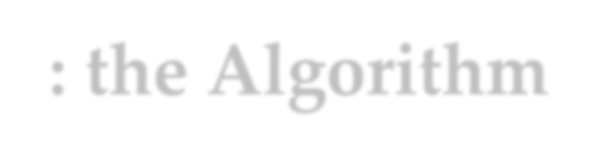



Heapsort: the Algorithm
Input: E, an unsorted array with n(>0) elements, indexed from 1
Sorted E, in nondecreasing order
Procedure:
void heapSort(Element[] E, int n) int heapsize
“array version”
constructHeap(E,n,root)
for (heapsize=n; heapsize≥2; heapsize--;) Element curMax=E[1];
Element K=E[heapsize]; fixHeap(E,heapsize-1,1,K); E[heapsize]=curMax;
Lecture^{r}s^{e}on^{tu}Alg^{r}o^{n}rith;m Design & Analysis (LADA) 2015
21

Slide 22



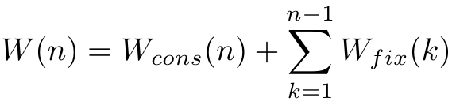
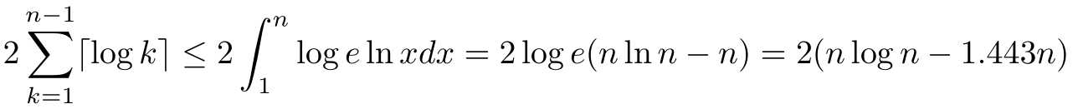
Worst Case Analysis of Heapsort
We have:
It has been shown that:
Recall that:
So, W(n) ≤ 2nlgn + Θ(n), that is W(n)∈Θ(nlogn)
Coefficient doubles that of mergeSort approximately

Slide 23

HeapSort: the Right Choice
For heapSort, W(n) ∈ Θ(nlogn)
Of course, A(n) ∈ Θ(nlogn)
More good news: HeapSort is an in-space algorithm (using iteration instead of recursion)
It will be more competitive if only the coefficient of the leading term can be decreased to 1

Slide 24
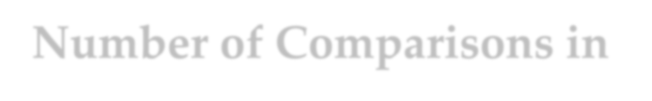



Number of Comparisons in fixHeap
Procedure:
fixHeap(H,K)
if (H is a leaf) insert K in root(H);
2 comparisons are
done in filtering
down for one level.
else
Set largerSubHeap;
if (K.key≥root(largerSubHeap).key) insert K in root(H)
else
insert root(largerSubHeap) in root(H);
fixHeap(largerSubHeap, K);
return

Slide 25








A One-Comparison-per- Level Fixing
Bubble-Up Heap Algorithm:
void bubbleUpHeap(Element []E, int root, Element K,
int vacant)
if (vacant==root) E[vacant]=K;
else
int parent=vacant/2;
if (K.key≤E[parent].key)
E[vacant]=K
else
E[vacant]=E[parent];
Bubbling up from vacant through to the root, recursively
bubbleUpHeap(E,root,K,parent);

Slide 26








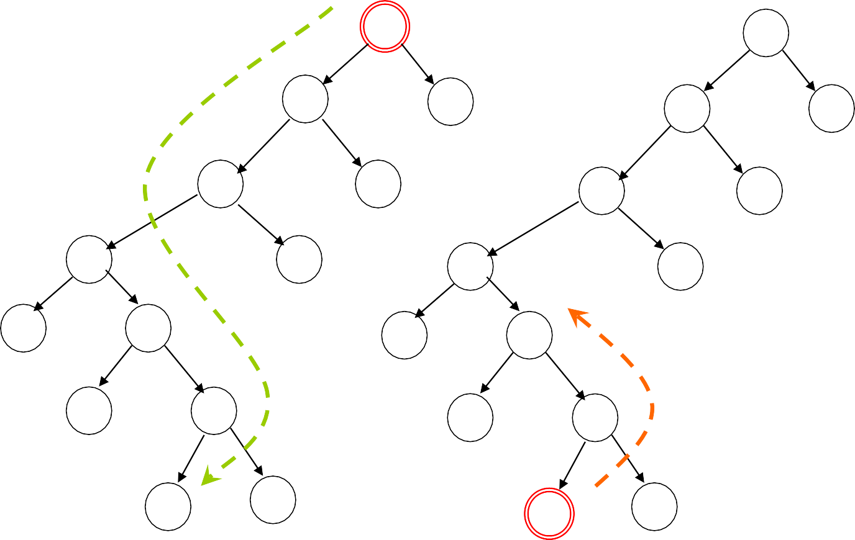



Risky FixHeap
In fact, the “risk” is no more than “no improvement”
“Vacant” filtering down:
left vs. right
90
90
65
80
65
80
75
70
75
70
35
60
35
25
60
25
50
Element(55) to be inserted bubling up: element vs. parent
45
50
45
40
40
15
15

Slide 27
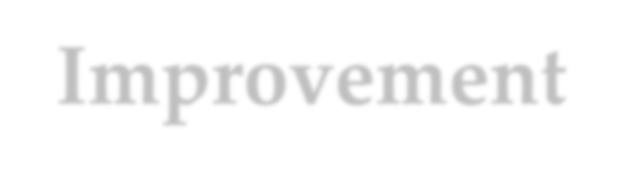





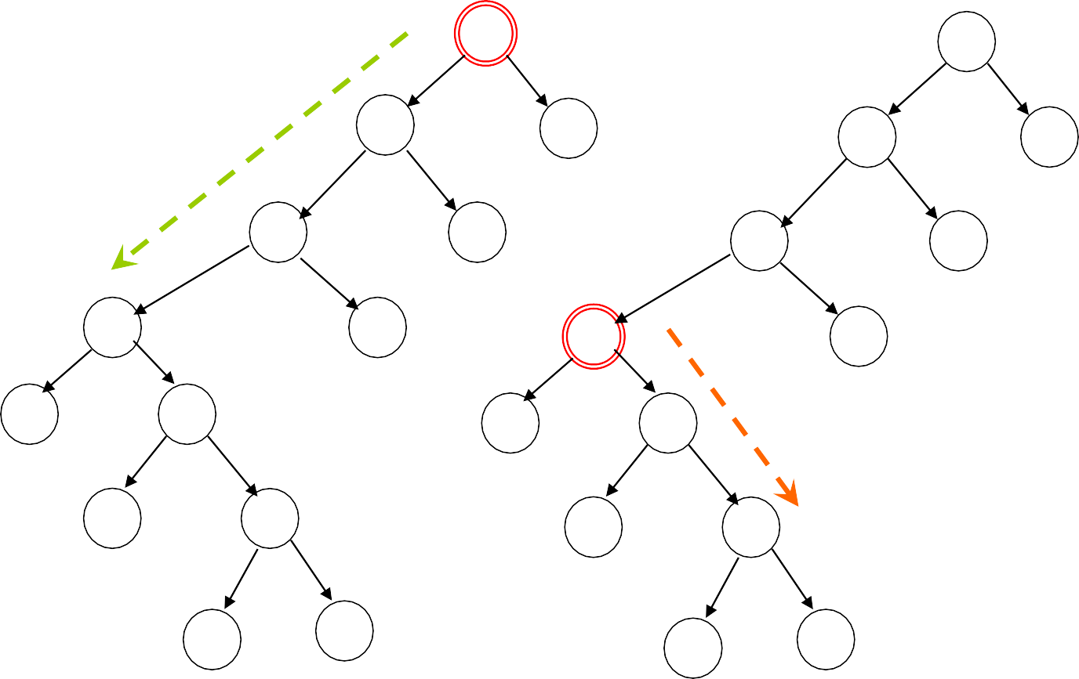






Improvement by Divide-and-Conquer
90
“Vacant” filtering down only half- way
90
65
65
80
80
75
70
75
70
35
35
25
60
60
If the element is smaller, filtering down half-half-way
25
45
50
45
50
15
40 40
15
The bubbling up will not beyond last vacStop

Slide 28


Depth Bounded Filtering Down
int promote(Element [ ] E, int hStop, int vacant, int h)
int vacStop;
if (h≤hStop) vacStop=vacant;
Depth Bound
else if (E[2*vacant].key≤E[2*vacant+1].key) E[vacant]=E[2*vacant+1]; vacStop=promote(E, hStop, 2*vacan+1, h-1);
else
E[vacant]=E[2*vacant]; vacStop=promote(E, hStop, 2*vacant, h-1);
return vacStop

Slide 29




FixHeap Using Divide-and- Conquer
void fixHeapFast(Element [ ] E, Element K, int vacant, int h)
//h=⎡lg(n+1)/2⎤ in uppermost call
if (h≤1) Process heap of height 0 or 1; else
int hStop=h/2;
int vacStop=promote(E, hStop, vacant, h); int vacParent=vacStop/2;
if (E[vacParent].key≤K.key) E[vacStop]=E[vacParent]; bubbleUpHeap(E, vacant, K, vacParent);
else
fixHeapFast(E, K, vacStop, hStop)

Slide 30
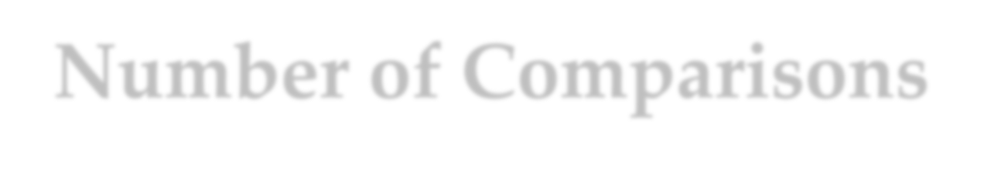



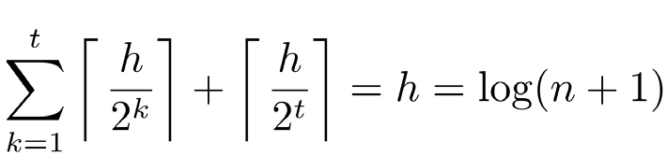
Number of Comparisons in Accelerated FixHeap
Moving the vacant one level up or down need one comparison exactly in promote or bubbleUpHeap.
In a cycle, t calls of promote and 1 call of bubbleUpHeap are executed at most. So, the number of comparisons in promote and bubbleUpHeap calls are:
At most, lg(h) checks for reverse direction are executed. So, the number of comparisons in a cycle is at most h+log(h)
So, for accelerated heapSort: W(n)=nlogn+Θ(nloglogn)

Slide 31



Recursion Equation of Accelerated heapSort
The recurrence equation about h, which is about log(n+1)
⎧ T (1) = 2
⎪
⎡ h ⎤ ⎛ ⎡ h ⎤
⎛ ⎢ h ⎥⎞⎞
⎨T (h) = ⎢ ⎥ + max⎜ ⎢ ⎥,1+ T ⎜ ⎢
⎥ ⎟⎟
⎪⎩
⎢ 2 ⎥
⎝ ⎢ 2 ⎥
⎝ ⎣ 2 ⎦⎠⎠
Assuming T(h)≥h, then:
⎧ T (1) = 2
⎪
⎡ h ⎤
⎛ ⎢ h ⎥⎞
⎨T (h) = ⎢ ⎥ +1+ T ⎜ ⎢
⎥⎟
⎪⎩
⎢ 2 ⎥
⎝ ⎣ 2 ⎦⎠

Slide 32








Solving the Recurrence Equation by Recursive Tree
For sorting a sequence of size n, n cycles of fixHeap are executed, so:
n (h+ ⎡log(h+1)⎤)
T(n)
⎡h/2⎤+1
T(⎣n/2⎦)
⎡h/4⎤+1
T(⎣n/4⎦)
⎡h/8⎤+1
⎡log(h+1)⎤ levels
So, the total cost is:
h+ ⎡log(h+1)⎤
T(1)
1+1

Slide 33





⎧ T (1) = 2
Inductive Proof
⎪
⎡ h ⎤
⎛ ⎢ h ⎥⎞
T (h) = +1+ T ⎜
⎪ ⎢ ⎥ ⎢
⎥⎟
⎩
⎢ 2 ⎥ ⎝ ⎣ 2 ⎦⎠
The recurrence equation for fixHeapFast:
Proving the following solution by induction:
T(h) = h+⎡log(h+1)⎤
According to the recurrence equation:
T(h+1)=⎡(h+1)/2⎤+1+T(⎣(h+1)/2⎦)
Applying the inductive assumption to the last term:
T(h+1)=⎡(h+1)/2⎤+1+⎣(h+1)/2⎦+ ⎡log(⎣(h+1)/2⎦+1)⎤
(It can be proved that for any positive integer:
⎡log(⎣(h)/2⎦+1)⎤+1= ⎡log(h+1)⎤ )
The sum is h+1
W(n)=nlogn+Θ(nloglogn) for Accelerated HeapSort

Slide 34




Thank you!
Q & A
Yu Huang yuhuang@nju.edu.cn http://cs.nju.edu.cn/yuhuang

